Slide 1



Applied Data Analysis (CS401)
Lecture 6
Causal analysis of observational data
25 Oct 2023
Robert West
Notes:
2020: 5 minutes over (incl. chat roulette), w/o doing “When Sheep Shop”
2021: exactly 90 min (but break shortened to 10 min)
2022: exactly 90 min (but break shortened to 10 min)
2023: 91 min (7 min of tech problems in beginning, so shortened break to 8 min)

Slide 2
Announcements
Homework H1 due on Fri 27 Oct 23:59
You can ask questions until Thu 23:59; we won’t answer questions asked after Thu
Project:
Milestone P1 feedback has been released
Milestone P2: get cracking once homework H1 is done!
Don’t use ChatGPT (one student already penalized on P1)
Friday’s lab session:
Exercises on causal analysis of observational data
Quiz 5

Slide 3
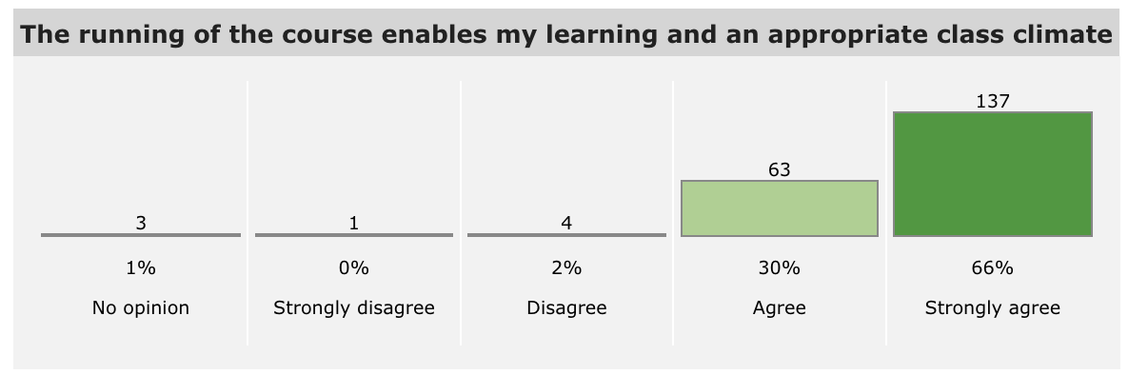
Course evaluation
Thanks for your feedback! -- We’ll use it to improve the class further
Most of you like the class and what you learn
Some concerns: class too hands-off (“more code!”); class too hands-on (“more theory!”); exercise sessions too crowded (?); quiz difficulty, wording, timing
Notes:
Quizzes:
Seem hard for everyone, so important to remember: grades will be shifted and scaled to get a fair distribution
Useful post-quiz discussions so far. To me a sign that they have pedagogical value

Slide 4
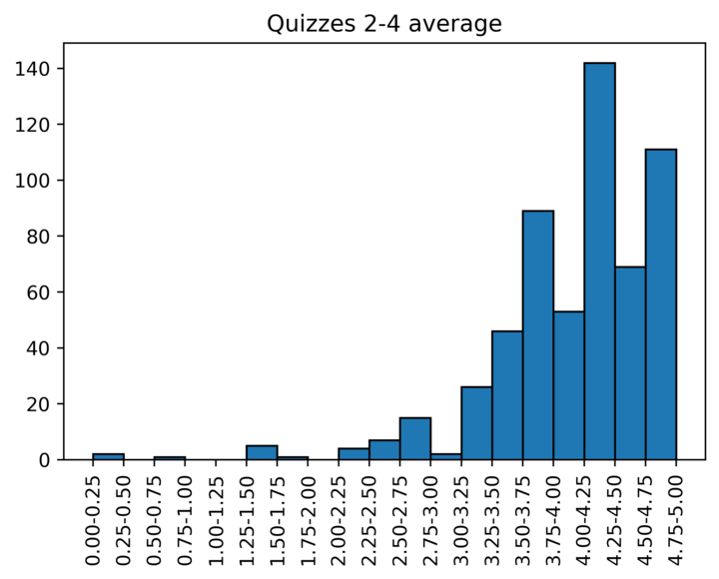
Quiz scores so far

Slide 5
Feedback
Give us feedback on this lecture here: https://go.epfl.ch/ada2023-lec6-feedback
What did you (not) like about this lecture?
What was (not) well explained?
On what would you like more (fewer) details?
…

Slide 6
Dr. Bob’s smoking cure
I claim to have developed a medicine that helps you quit smoking
I ask all smokers: “Do you want to try my medicine?”
Smokers = {treated smokers} ⋃ {untreated (“control”) smokers}
Fraction of successful quitters is higher in the treated group
I conclude: “My medicine helps you quit smoking! Buy it!”
Do you believe me?

Slide 7
Goals of this lecture
Clarify difference between experimental and observational studies
Highlight pitfalls of observational studies
Give you tools for avoiding the pitfalls, allowing you to draw valid conclusions from “found data” (very useful for project!)
Motivate you to read Rosenbaum’s great book “Design of Observational Studies” (in particular Chapters 1, 2, and 3; or this book) and Pearl’s eye-opening “Book of Why”
Notes:
So you never speak of an experiment any more when you actually mean an obs study
Not only in 3rd year of PhD…

Slide 8
Dr. Bob’s “experiment” as a causal diagram
Motivation to quit smoking etc.
“Confounder”💀💀💀
“Treatment”
“Outcome”
Take Dr. Bob’s medicine
Quit smoking
Notes:
Semantic of arrows: cause and effect:
Manipulating the quantity on the start point changes the quantity on the end point
So this arrow is what Dr. Bob claims when trying to sell you his smoking cure
…
In presence of confounder, you are measuring a mix of the effects of treatment and confounders; don’t know what part of effect comes from which, …
(p.t.o.)

Slide 9
Dr. Bob’s “experiment” as a causal diagram
Motivation to quit smoking etc.
“Confounder”💀💀💀
“Treatment”
“Outcome”
Take Dr. Bob’s medicine
Quit smoking
Notes:
… and the association between treatment and outcome could be there even without any causal link

Slide 10
Ideal setting as a causal diagram
Motivation to quit smoking etc.
Take Dr. Bob’s medicine
Quit smoking
Notes:
Here, motivation doesn’t affect treatment → level of motivation same in treated and control, as desired
Ideal way to achieve this (not possible): for any person, observe their quitting behavior in two parallel worlds:
(1) They take Bob’s medicine
(2) They don’t take Bob’s medicine
(everything else being the same) (i.e., every person included in both treatment and control groups)
Alas, there is only one world
To approximate the ideal parallel-worlds situation:
Want to control treatment ourselves (as researchers), observe outcome
In doing so, want to make sure motivation (and any other potential confounders, for that matter) has no influence on who gets the treatment
= deleting all arrows leading to treatment
In practice: randomize (then same distribution over motivation among treated and control)

Slide 11
Randomized controlled experiments
Two experimental conditions:
Treatment (e.g., medicine)
Control (e.g., placebo [fun fact])
Assignment of participants to conditions is random
Probability of receiving treatment same for everyone
Treatment and control groups are indistinguishable
E.g., determination to quit smoking is not systematically higher in the treated group
Notes:
…
Why placebo, rather than simply taking no action? → want to keep identical as many things as possible, incl. belief of (maybe) taking an effective medicine, frequency of seeing nurse who administers medicine, act of putting pill into mouth, etc.
Placebo effect may happen even when subject knows they’re given a placebo (see link)
…

Slide 12
Randomized controlled experiment as a causal diagram
Motivation to quit smoking etc.
Take Dr. Bob’s medicine
Quit smoking
Notes:
Randomization takes arrow away, as confounds cannot influence decision to treat anymore (CLICK)

Slide 13
Randomized controlled experiment as a causal diagram
Motivation to quit smoking etc.
Take Dr. Bob’s medicine
Quit smoking
Notes:
Coin is an indifferent dictator (money rules…) (CLICK)

Slide 14
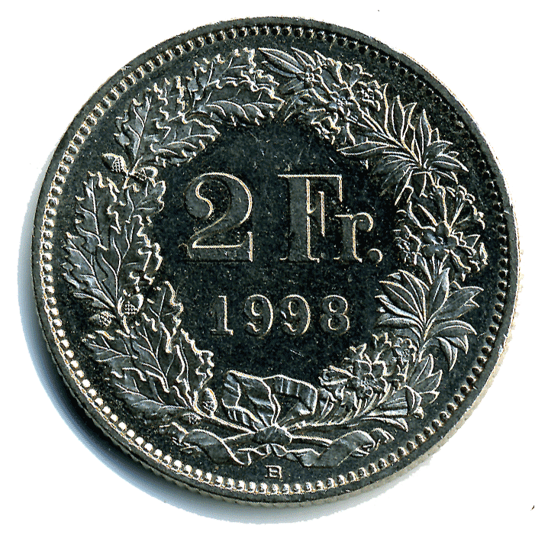
Randomized controlled experiment as a causal diagram
Coin
Motivation to quit smoking etc.
Take Dr. Bob’s medicine
Quit smoking
Notes:
More explicit: replace bad arrow with an arrow from the coin outcome, which is not affected by anything else

Slide 15
Limits of randomization
Do seat belts save lives?
Experiment:
Flip coin at birth to assign to treatment (always wear seat belt for entire life) or control (never wear seat belt)
Measure fraction of traffic deaths in each group
Randomized experiments aren’t always feasible
Unethical (see above), expensive, fundamentally impossible (e.g., do earthquakes decrease life spans?)
Most modern “big data” is “found data”
Experiments may lead to unrealistic scenarios
Notes:
Question: not everybody would answer “yes” (Albania)
DPRK
Obs studies better suited as they let us observe subjects in their natural habitat: e.g., nutrition: making people eat salt leads to unnatural form of salt intake (pills)

Slide 16
Alternative: observational studies
Fundamentally different from experiment:
Researcher can’t control who goes to which condition
Researcher is merely an observer, not a tinkerer
Much less problematic w.r.t. ethics, price, feasibility
Much more problematic w.r.t. validity of conclusions
All advantages of randomized experiment are gone
Subjects self-select to be treated
Treatment assignment and response may be caused by same hidden correlate (a.k.a. confounders; e.g., motivation to quit smoking)
Notes:
…
Re: validity: Classic case: smoking vs. lung cancer
Much of the methodology we’ll cover today was developed as a resolution of the smoking debate
Initial “experiment” about Dr. Bob’s smoking cure was really an observational study (and a poorly designed one)

Slide 17
Example: seat belts revisited
Recall: experiment infeasible because unethical
Observational study:
Dataset: all traffic accidents in a given time span
Two treatment conditions:
Treated: seat-belt wearers
Control: non-seat-belt wearers
Compare fraction dead in treated vs. control
What problems do you see?

Slide 18
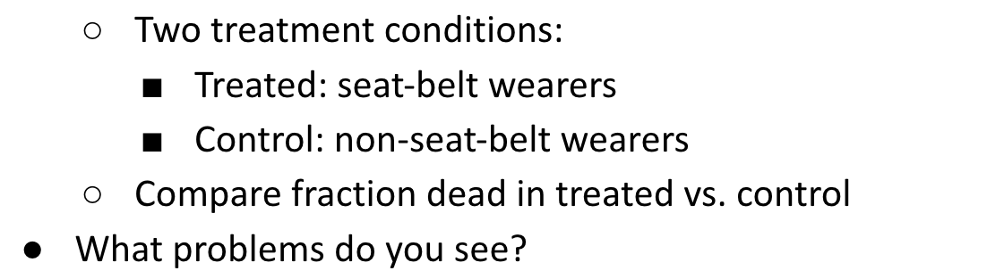
THINK FOR A MINUTE!
(Feel free to discuss with your neighbor.)
Notes:
Then: share

Slide 19
As a causal diagram
Driver’s cautiousness
Severity of crash
?
Survival
Seat belt
Notes:
(Re: previous slide)
Some potential confounds
Willingness to take risks
Driving off in a hurry (forget seat belt, drive fast)
Being drunk (forget seatbelt, drive dangerously)
Old cars might lack both seat belts and airbags
etc.

Slide 20
A matched observational study
Consider only a particular subset of accident cars:
2 people in car: driver + passenger
Exactly one of them died in accident
Exactly one of them wore seat belt at time of accident (i.e., 1 treated + 1 control per car)
As before: compare fraction dead in treated vs. control
New: many potential confounders are controlled for, incl. type of car, speed, severity of accident
Fundamental concept: matching
Notes:
…
Explain difference between individual vs. paired study

Slide 21
As a causal diagram
Driver’s cautiousness
Severity of crash
Seat belt
Survival
Notes:
Smart subselection of data points (“adjustment”)
→ Driver’s cautiousness does not change fraction of belted people in any car
What could still happen? (Think for a bit!)
Different confounds (and mediators) are still possible; e.g., position of seat-belt wearer
Passenger more likely to be drunk, therefore less likely to be belted, but also more likely to die → potentially spurious correlation of belt and death
Being driver could increase prob of wearing seat-belt (e.g. because less likely to be drunk) and increase prob of dying (because of steering wheel) → this could cancel out true positive effect of belt
etc.
→ addressed by more fine-grained analysis, cf. next slide

Slide 22
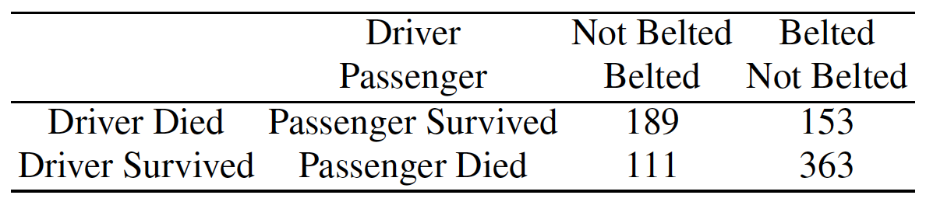
Settling the seat-belt question
Notes:
“Contingency table”
A priori: driver or passenger might be in a more dangerous position
Contingency table lets us study each constellation individually
(Explain how to read table: 2x2: who was belted, who died)
NB: passengers indeed less likely to be belted (column sum 300 vs. 516)
But: regardless who was belted, the belted person was always more likely to survive (more weight on diagonal)
This is the art of science! Always be on the lookout to identify situations in the real world that might allow you to learn about cause and effect

Slide 23
Natural experiments
Not researcher, but nature, “flips a coin” to decide treatment assignment
Rosenbaum: “When investigators are especially proud, having found unusual circumstances in which treatment assignment, though not random, seems unusually haphazard, they may speak of a ‘natural experiment.’”
Examples: twin studies, Vietnam draft, cholera in London
Is matched seat-belt study a natural experiment?
Notes:
When you’re looking at the world this way, you’re sometimes lucky and may find situations that are nearly like an experiment, but …
…
“Nearly a nat exp”: conditions not fully met by seat-belt study (but circumvented by doing a tad of extra work to analyze the contingency table)
Improved design: consider cars w/ 4 passengers, study only 2 back passengers; or self-driving cars
How could this still fail?
Maybe certain group of people (e.g., men) less likely to wear belt and more vulnerable to impacts of head on glass…
Always stay critical of your design!
Next: tools to address these concerns (via probability to treat)

Slide 24
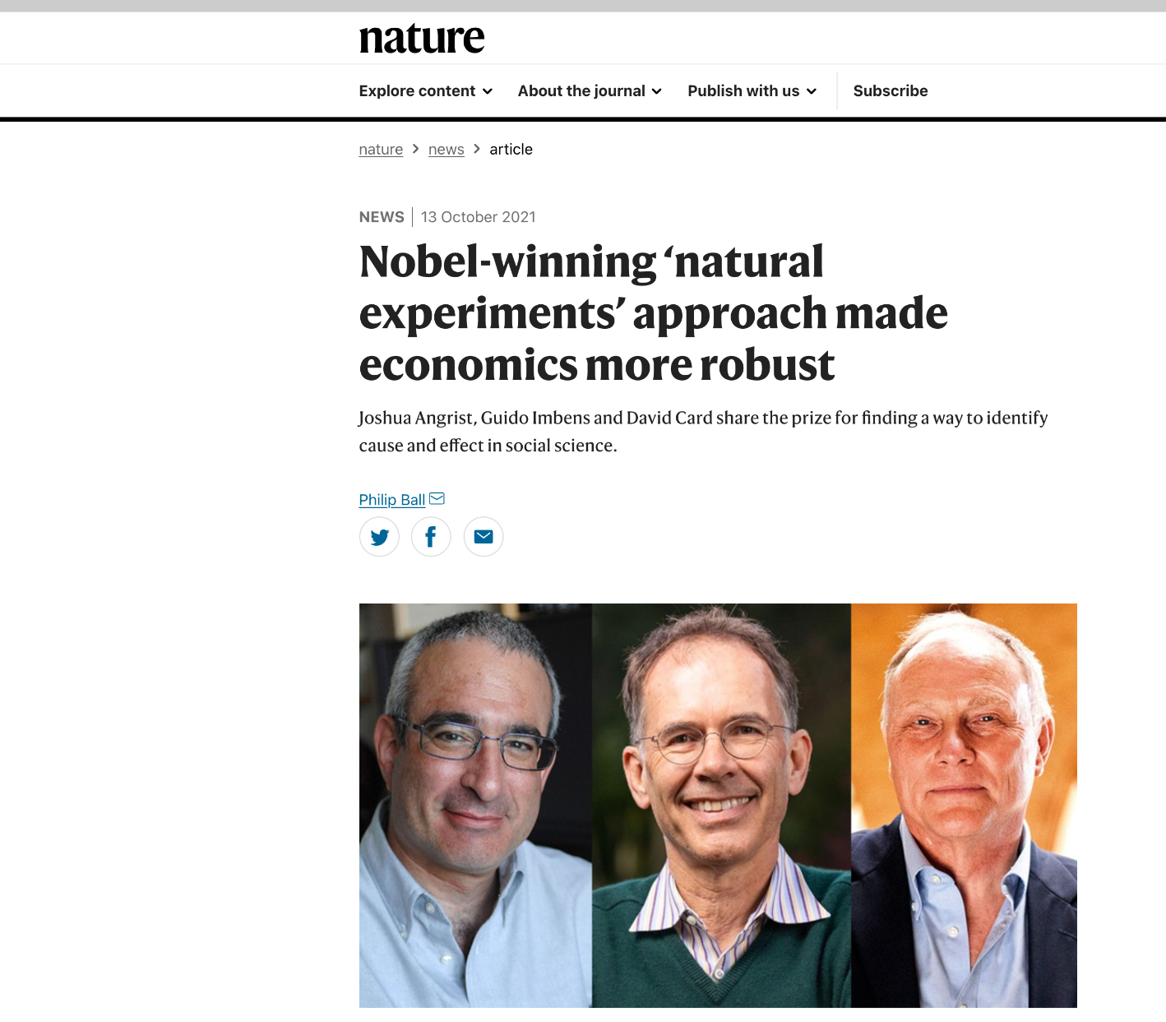
Notes:
Who had heard of natural experiments before this lecture? (CLICK)
https://www.nature.com/articles/d41586-021-02799-7

Slide 25

Nature didn’t flip a coin for me – should I just go home and weep?
Notes:
Nature didn’t flip a coin for you
so, no Nobel Prize for you
should you just go home and weep?

Slide 26

Commercial break
Don’t go home and weep!

Slide 27

Nature didn’t flip a coin for me – should I go home and weep?
No! You can still get good mileage if you’re smart about it
Fundamental concept: matching
Ideally: Pair up 2 identical people:
1 treated, 1 control
Ex-post (vs. natural experiment: ex-ante)
Compare outcome of treated vs. control
e.g., mean difference treated-minus-control
or regression analysis (see last lecture)
Notes:
Similar to pairing in seat-belt study, but here done after the fact (“ex-post”); there, before (“ex-ante”, by sitting in same car)
Advantages of regression (see last lecture; e.g., quantification of uncertainty “for free”)

Slide 28


Matching
Ideally: Pair up 2 identical people:
1 treated, 1 control
Such ideal matching usually not feasible
Problem 1: Unobserved covariates: You usually can’t even know if two people are identical
Problem 2: Combinatorial explosion: (Nearly) no two people are identical

Slide 29

Problem 1: Unobserved covariates
You usually can’t even know if two people are identical
e.g., (hypothetical) gene that causes both desire to smoke and lung cancer
Let’s ignore Problem 1 (for now)!
Notes:
…
Naive “solution”: pretend there’s no problem to begin with
Let’s look more closely what ignoring the problem of unobs covariates actually means (p.t.o.)

Slide 30
Addressing Problem 1 by ignoring it: A naive model
“People who look comparable are comparable”
or equivalently:
“Only observed covariates determine treatment assignment”

Slide 31
Naive model as a causal diagram
Unobserved covariates
Observed covariates
Treatment
Outcome
Notes:
Undirected edge b/w obs and unobs covariates: they’re not independent (but we don’t care in what precise ways they’re dependent)
Unobs cov can even affect Outcome -- they just can’t affect treatment, except via observed vars

Slide 32
If the naive model were true…
… you could “simulate” a randomized experiment:
Simply match subjects with identical observed covariates (1 treated, 1 control)
Subjects in a pair have the same probability to treat
So who gets treated is up to chance, as in experiment
Analysis: compare outcome for treated to outcome of control (e.g., mean difference treated-minus-control)
Problem 2!
Notes:
Not so “simple”!

Slide 33
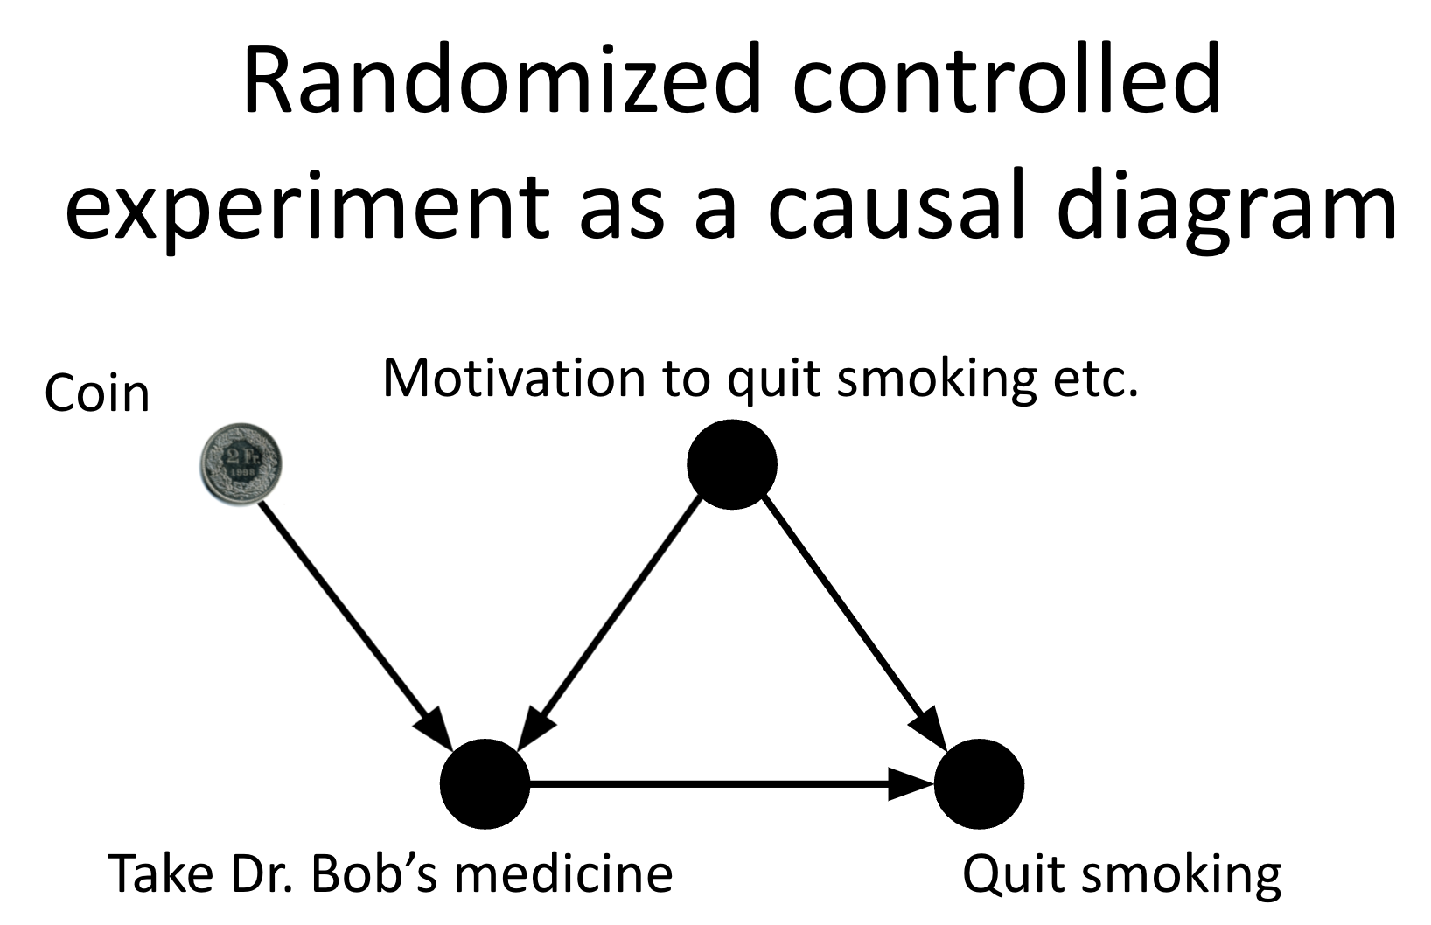
Problem 2: Combinatorial explosion
(Nearly) no two people are identical
So finding two people to match is often impossible
Even when considering only observed covariates (as in the naive model)
Do we really need to match people with identical covariates?
Recall “holy grail”: randomized controlled trials
Coin makes sure everyone has identical probability to be treated
→ Let’s mimic what the coin does!
Notes:
E.g., 20 binary attributes: 1M different constellations (even worse for attributes w/ >2 possible values)

Slide 34
Addressing Problem 2: Propensity score
Compress the (potentially many) observed covariates into a single number: the probability to receive the treatment (a.k.a. propensity score): Pr(subject is treated | observed covariates)
Can be estimated from the data
E.g., via logistic regression (see next lecture)
Input: observed covariates
Output: treatment indicator (1 if treated, 0 if control)
Notes:
…
For today’s lecture, not important how you estimate PS. Important fact: it can be done w/ the data you have

Slide 35
Propensity score as a causal diagram
Observed covariates
…
Propensity score
Treatment
Outcome
Notes:
PS like a bottleneck: all info about treatment that’s contained in obs covs is condensed into one single scalar
Obs covs matter only insofar as they change the PS
Obs covs can still independently influence outcome, but that’s not a problem:
For a fixed PS, distribution over obs covs is identical in all treatment groups
a.k.a. “balancing property” of PS (see next slide)

Slide 36
Balancing property of propensity score
Fact: all subjects (treated and control) with equal propensity score (PS) p have equal distribution of observed covariates x: Pr(x | treated = 1, PS = p) = Pr(x | treated = 0, PS = p)
Subjects in a matched pair might not have equal x, but treated and control groups will have similar distributions of x

Slide 37
Balancing property is propensity score’s raison d’être
There are many other methods for achieving balance
e.g., exact matching, Mahalanobis distance matching, coarsened exact matching, …
You can mix and match methods (e.g., match exactly on gender, use propensity scores for other covariates)
What eventually matters is whether you achieve balance
Regardless of how you try to achieve balance, you need to verify that you managed to achieve balance (p.t.o.)

Slide 38
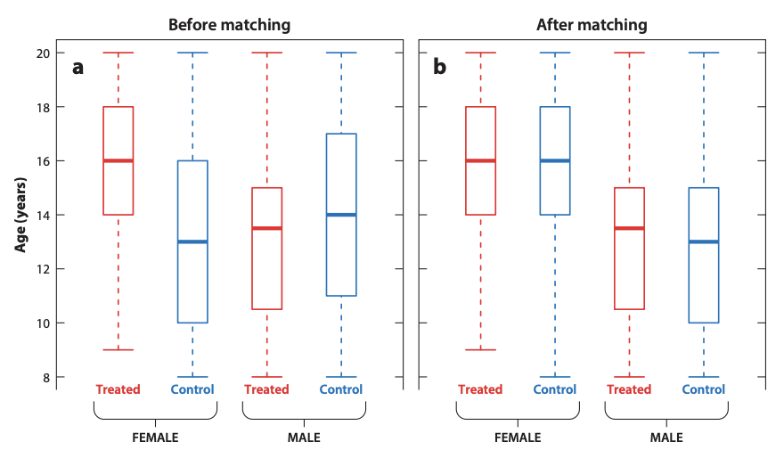
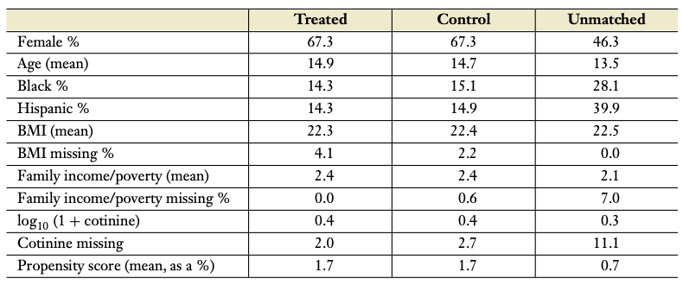
Assessing covariate balance
Before matching
After matching
Notes:
Options (can do multiple):
Viz
Inspect table
Conduct statistical tests to assess whether distributions for a given covariate are different in treatment vs. control

Slide 39
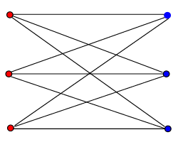
Matching algorithms
Goal: Match subjects into pairs (1 treated, 1 control), with identical propensity scores within each pair
Unlikely that 2 subjects have identical propensity scores
→ Use approximate matching (remember your algo class!)
Bipartite graph: each subject connected to all other subjects
Edge weights: absolute (or squared) difference of propensity scores (or other matching criterion)
Find minimum matching, e.g., via Hungarian algorithm

Slide 40
Ok, so are we done?
Problem 1: Unobserved covariates: You usually can’t even know if two people are identical
Let’s ignore Problem 1!
We’ve been assuming the naive model:
“Only observed variables determine treatment assignment”
Notes:
Uh-oh, wasn’t there something?
…

Slide 41
If the naive model isn’t true...
… propensity score may differ from true probability to treat: Pr(treated | observed covariates) ≠ Pr(treated | all covariates)
have this
need this

Slide 42
Violated naive model as a causal diagram
Unobserved covariates
Observed covariates
…
Propensity score
Treatment
Outcome
Notes:
All advantages are gone!
Unobserved covariates might make all the difference! (e.g., smoking genes)

Slide 43
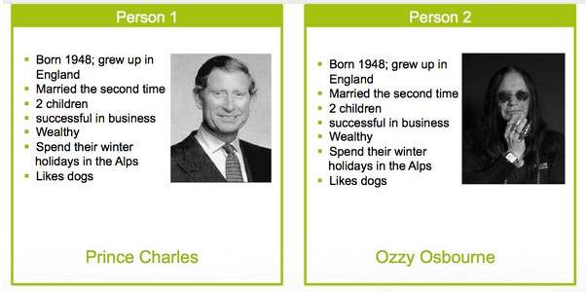
If the naive model isn’t true...
… you may end up matching
King
Notes:
E.g., if these are our obs covs, p1 and p2 look identical ⇒ same prop score, great matching candidates
But in fact couldn’t be more different (CLICK)
E.g., if becoming king (CLICK) is the treatment you’re interested in studying, then p1 has a higher prob to receive the treatment

Slide 44
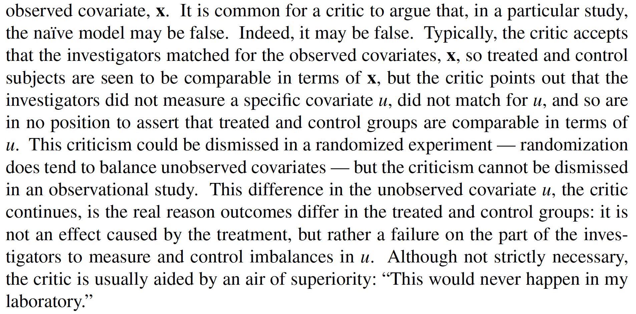
The naive model is easily attacked
Rosenbaum:

Slide 45
The sensitivity analysis model
Idea: Quantify the degree to which the naive model may be wrong without you having to change your (causal) conclusions
Assume that treatment odds of identical-looking subjects (i.e., identical observed covariates x) may differ by up to a factor Γ
Then reason in spirit of proof by contradiction: “To change the conclusions of my study, two identical-looking people (1 treated, 1 control) would have to have hugely different treatment odds (i.e., huge Γ). Common sense (or domain knowledge) suggests that this is not the case, so my conclusions stand.”

Slide 46
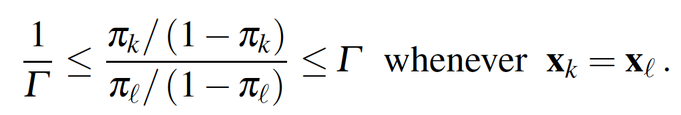
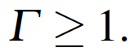
The sensitivity analysis model
Bounded odds ratio (OR)
Reason for using OR: OR = Pr(k treated | either k or ℓ treated) / Pr(ℓ treated | either k or ℓ treated)
Sensitivity Γ = 1 → naive model is true
Sensitivity Γ = 2 → subject with same observed covariates x up to twice as likely to be the one to receive treatment
Sensitivity Γ = ∞ → void statement (a.k.a. tautology)
subject ℓ’s (true) probability to treat
Notes:
Derivation of what OR captures: \frac{ \;\;\;\frac{\pi_k (1-\pi_\ell)}{\pi_k (1-\pi_\ell) + \pi_\ell (1-\pi_k)} \;\;\; } { \frac{\pi_\ell (1-\pi_k)}{\pi_k (1-\pi_\ell) + \pi_\ell (1-\pi_k)} } = \frac{\pi_k/(1-\pi_k)}{\pi_ell/(1-\pi_ell)}
Emphasize: you don’t know any of \Gamma, \pi_k, \pi_l!
You just want to quantify how large \Gamma would need to be in order to change your conclusions re: causal effect (see next slide)

Slide 47
Example: smoking and lung cancer
Under naive model: matching on observed covariates gives a very small p-value for the null hypothesis that smoking does not increase lung cancer risk (using an appropriate hypothesis test), i.e., data hard to explain w/o a causal effect
Tobacco lobby: “The naive model isn’t true! There may be hidden (e.g., genetic) correlates that increase both the probability to enjoy smoking and the probability of lung cancer. They, not smoking, cause cancer!”

Slide 48
Example: smoking and lung cancer
Under sensitivity analysis model, increasing sensitivity Γ increases the p-value for null hypothesis
Anti-tobacco lobby: “But making p > 0.05 would require Γ > 6; i.e., the odds of being a smoker would need to be six times higher for one of two people with the exact same observed features (age, gender, education, income, ...). It’s unlikely that any unobserved covariate would have such a large effect on smoking habits. So smoking causes cancer!”
Notes:
For larger \Gamma: even if there is actually no effect (H0 is true), we’re more likely to falsely observe an effect, because identically-looking people have different treatment probabilities,
so the observed effect could stem from unobserved covariates (which cause the different treatment probabilities), rather than from treatment
In fact, in this case, it could even be driven ad absurdum. To achieve \Gamma=6, a certain probability parameter would have to be > 1

Slide 49
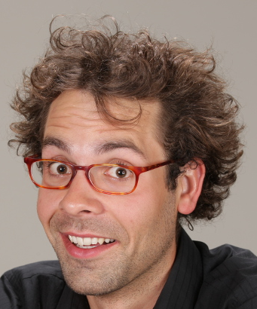
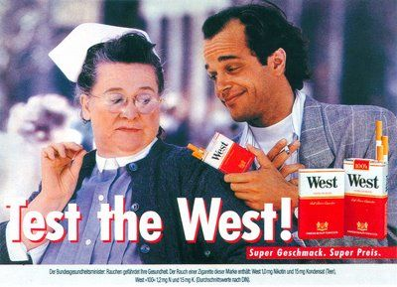
Notes:
Of course, this is all bogus
Smoking does not cause cancer
Rather, it is a joyful and healthy pastime
After this lecture, go buy cigarettes and smoke
And consider smoking West, mmmmm

Slide 50
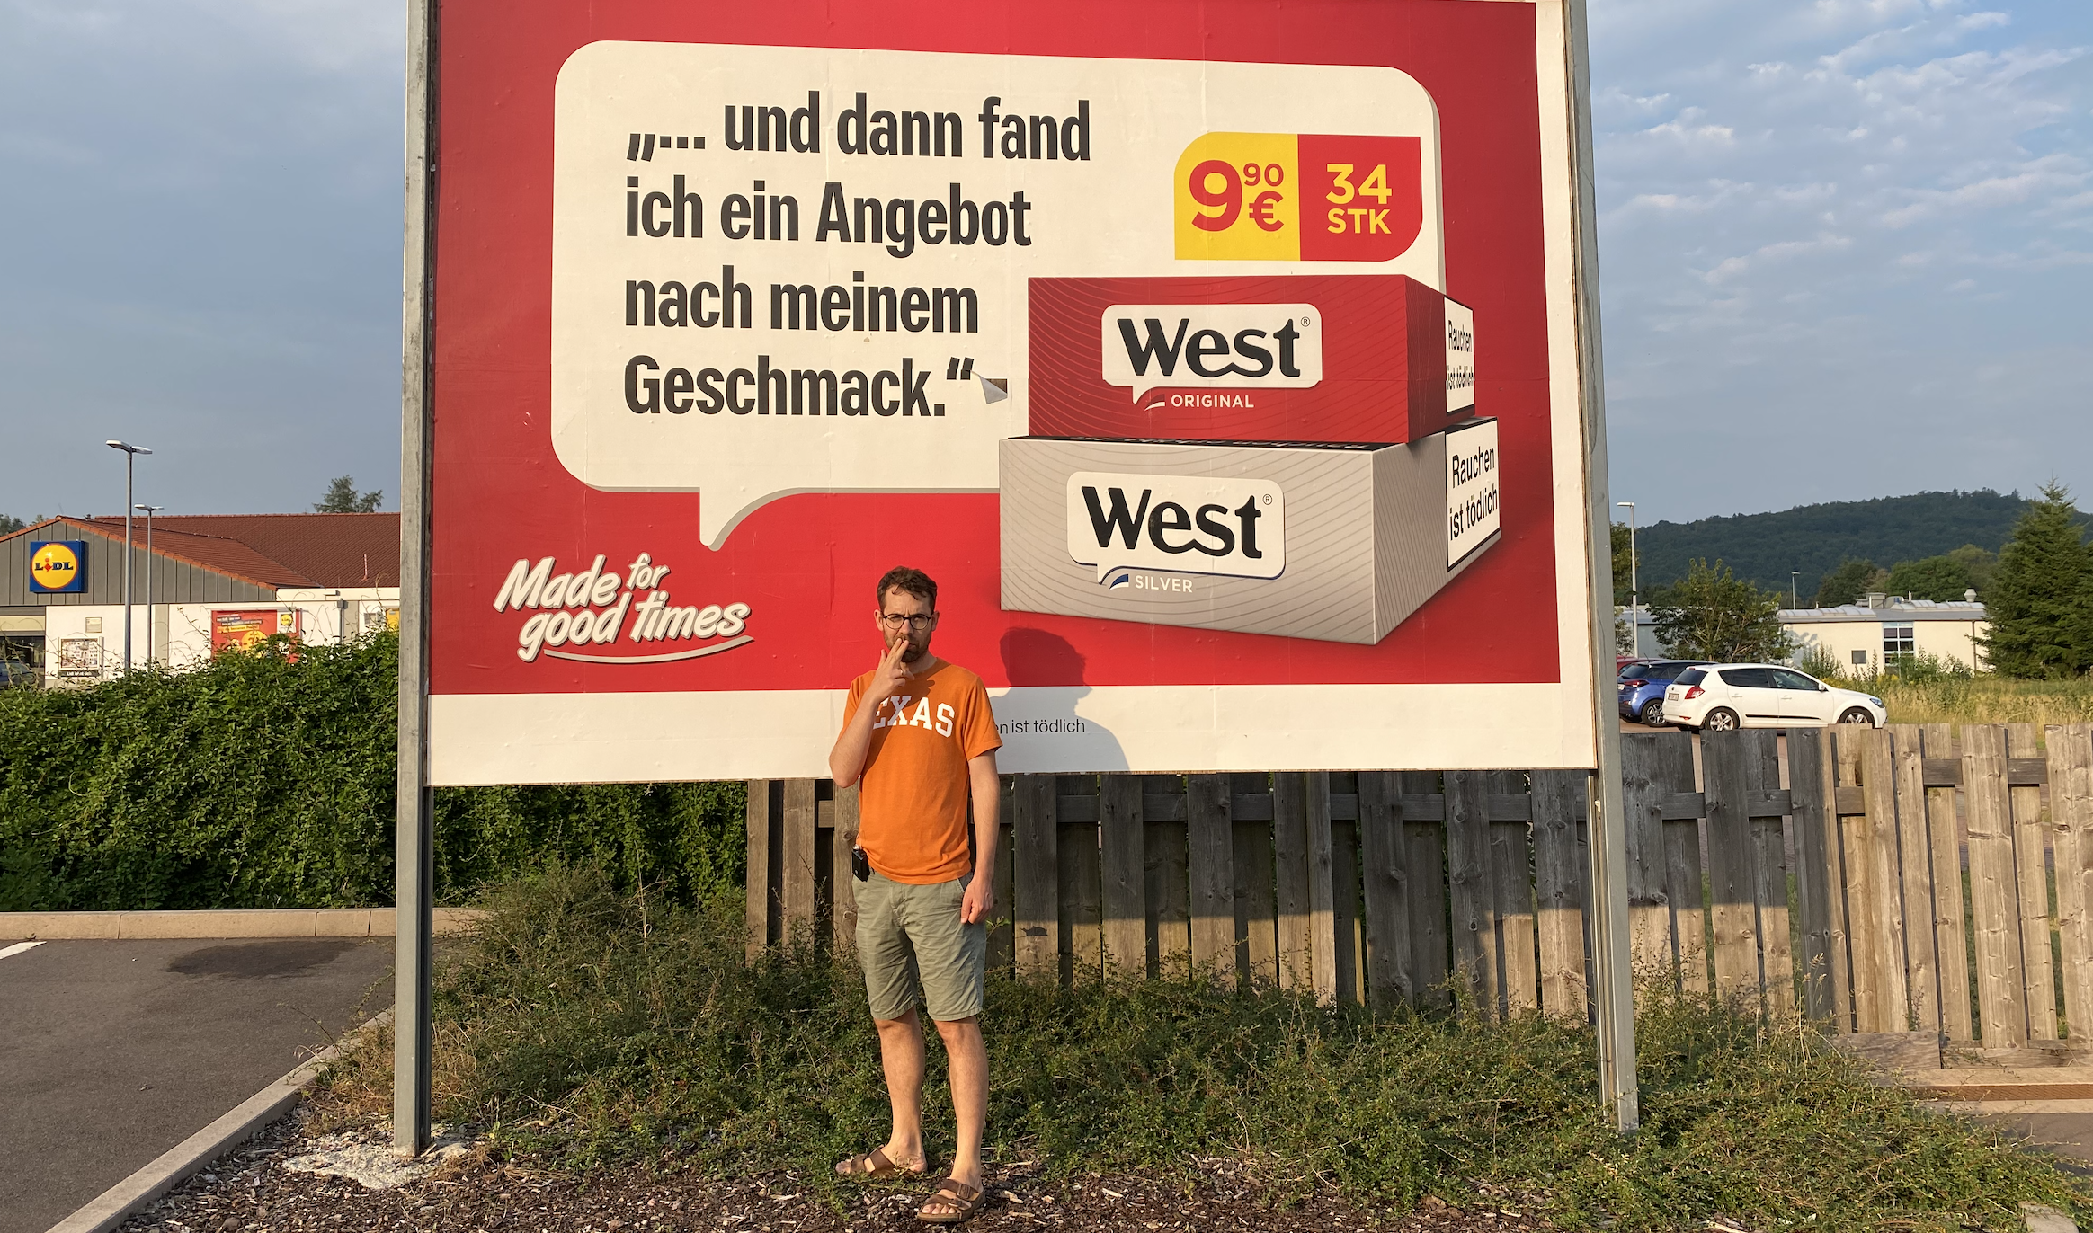
Notes:
They’re only EUR 9.90 for a pack of 34

Slide 51
Two parts: mechanical vs. scientific
Mechanical part:
Create pairs (1 treated + 1 control) with similar observed covariates (using exact or propensity-score matching)
Scientific (i.e., fun) part:
Mitigate concerns that your findings might be caused by unobserved covariates, rather than treatment (e.g., using sensitivity analysis, ad-hoc arguments, natural experiments)

Slide 52
Summary
Holy grail: randomized experiment
When experiment not possible: observational study
Crucial problem: treatment assignment not random (biases!)
Semi-holy grail: natural experiment
Matched studies: pair up treated/control based on observed covariates
Problem: still, treatment assignment not random (biases via unobserved covariates)
Solution: sensitivity analysis
Keep this lecture (more here) in mind for your projects!
Notes:
TopiCSS experience

Slide 53
Feedback
Give us feedback on this lecture here: https://go.epfl.ch/ada2023-lec6-feedback
What did you (not) like about this lecture?
What was (not) well explained?
On what would you like more (fewer) details?
…

Slide 54
Credits
Much of the material is based on Paul Rosenbaum’s amazing book “Design of Observational Studies”, available for free here

